Slide 1
The Zero Player Game
A python Implementation of Conway's Game of Life
Richard Frost, Oakland University, 13 April 2021

Slide 2
Conway’s Game of Life
Conway’s Game of Life is a ‘zero player game’ proposed by British Mathematician John Conway.
A player fills in spaces on a grid. Then the grid progresses by a set of 4 rules without any other player input. The rules are as follows:
A filled cell with fewer than 2 filled neighbors becomes unfilled
A filled cell with 2 or 3 filled neighbors remains filled
A filled cell with more than 3 filled neighbors becomes unfilled
An unfilled cell with exactly 3 filled neighbors becomes filled
The visual component is a GUI that allows for easy selection of initial filled cells

Slide 3
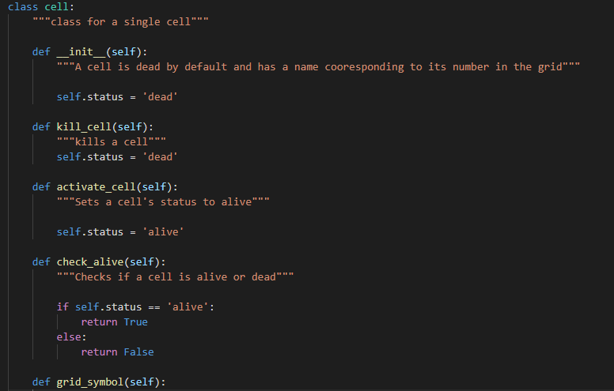
Cell Class
Each space in the grid contains a cell defined by the cell class.
Each Cell has a status of either alive or dead
The cell class has functions to kill, activate, or check the status of the cell.

Slide 4
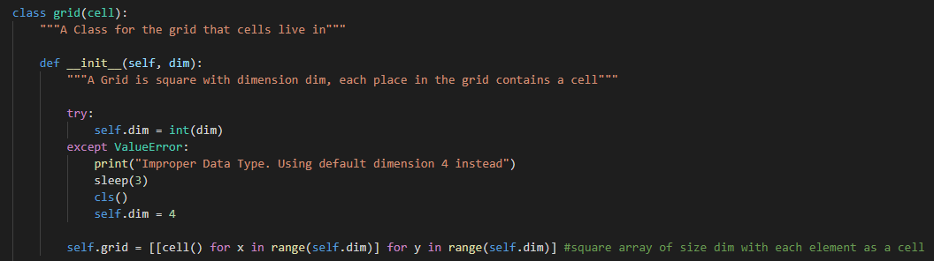
Grid Class
The grid class is in essence a 2D array of cells. Hence the grid class inherits from the cell class.
The grid class contains functions to:
Print the grid in the console
Advance the grid by a single generation
The grid has the attribute self.dim which is the size of one side of the grid in cells. Hence, the grid is always square.

Slide 5
Input_Gui Class
The Input_Gui Class creates a GUI that allows for easy input of cell status by the user. The GUI is created using the tkinter module.
The Input_Gui uses the same dimension as the grid class to create an array of buttons. The buttons that are pushed become living cells in the grid class.

Slide 6
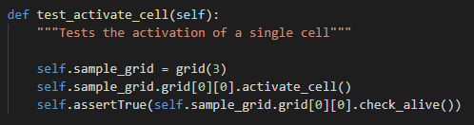
Test Cases: Activate and Kill Cell
Verifies that cells that are activated/killed have the correct status

Slide 7


Test Case: Advance Grid
Checks the advance_grid method by verifying a known grid advancement.
Should Go To

Slide 8
Test Case: Default Grid Size
This test case checks that a certain exception is handled correctly.
There is minimal user input that can be ‘screwed up’ but if a string is somehow passed into the Grid or Input_Gui class as its dimension the class will set the dimension to 4 to prevent a crash.

Slide 9
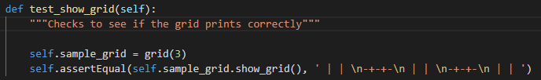
Test Case: Show Grid
This tests that the console output of the advancing grid is correct for a grid with dimension 3

Slide 10
Exceptions
There are not a whole lot of exceptions, because there isn’t a lot of user supplied input.
A ValueError is handled if a string is inputted for instead of an int for the dimension
A DimensionRangeError Exception is thrown if a grid dimension is less than 3 or greater than 30.
A dimension of 2, 1, or 0 doesn’t do anything
A dimension of larger than 30 doesn’t work well in the console

Slide 11
Lessons Learned…
I think I learned a lot about handling a larger project.
I learned that writing out pseudocode on paper to break down more complex logical lines is really helpful.
Tkinter was a real pain to work with in all honestly, but it did push me to seek out new resources online to help me.
Like a 7 hour crash course video ha ha

Slide 12
Github?
Have a strange burning need to look at my code?
Here’s a link: https://github.com/rfrost114/Game-of-Life

